Slide 1
TASK-3 Songs Analysis in Power BI
PRESENTED BY
Pallavi Raj

Slide 2
Content
Project Overview
Dataset Description
Problem Statement
Analysis(Queries)
Summary

Slide 3
Song Analysis
Overview:
The song analysis project in Power BI aims to explore YouTube song’s performance, popularity, and user engagement through visualizations and reports. By analyzing metrics like views, likes, and comments, the project identifies trends and patterns. The insights help content creators and stakeholders optimize song content for better engagement and performance.

Slide 4
Columns Description:
video_id: Unique identifier for each YouTube video.
ChannellTitle: Title of the YouTube channel publishing the song.
title: Title of the YouTube song video.
description: Description provided for the YouTube song video.
tags: Tags associated with the YouTube song video.
publishedAt: Date and time when the YouTube song video was published.
viewCount: Number of views received by the YouTube song video.
likeCount: Number of likes received by the YouTube song video.
favoriteCount: Number of times the YouTube song video has been marked as a favorite.
commentCount: Number of comments posted on the YouTube song video.
duration: Duration of the YouTube song video.
definition: Video definition or quality (e.g., HD, SD).
caption: Availability of captions for the YouTube song video.

Slide 5
Problem Statement
The internship project involves analyzing YouTube songs data using Power BI to generate interactive dashboards and detailed reports. The dataset includes attributes like video ID, channel title, view count, like count, and more. The analysis aims to uncover trends and patterns to help content creators and stakeholders optimize their YouTube song content. Deliverables include interactive dashboards, detailed reports, and actionable recommendations to enhance video performance and engagement, providing interns with practical experience in data analysis and content optimization.

Slide 6
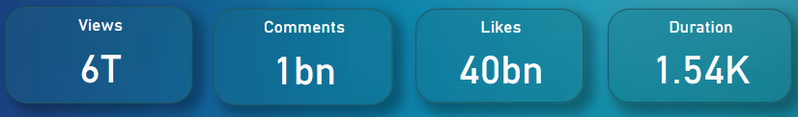
Visualization and it’s inferences
The total view count across all songs is 6,000 billion, indicating a massive cumulative audience reach.
The total number of comments across all songs is 1 billion.
There are total 40 billion likes.
The duration of total YouTube songs being 1.54k typically means 25.67 minutes or 1,540 seconds.

Slide 7
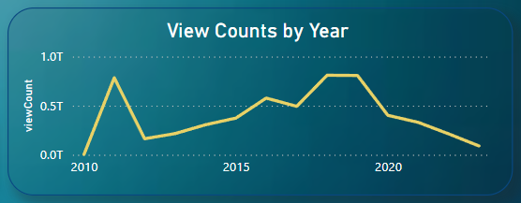

Slide 8
Inference:
The line chart titled "View Counts by Year" displays the trend of YouTube song view counts from
2010 to 2023.
Peak in Early 2010s: There was a significant spike in view counts around 2011, reaching close to 1.0 trillion views.
Fluctuations: After the peak, view counts experienced fluctuations, with noticeable dips and rises.
Steady Rise and Fall: From 2015 to around 2020, there was a general increase in view counts, peaking again around 2020.
Decline Post-2020: Post-2020, there is a marked decline in view counts, dropping to below 0.5 trillion views by 2023.
Possible Interpretations:
Early Viral Hits: The spike around 2011 could indicate the popularity of early viral music videos.
Platform Growth: The steady rise towards 2020 suggests increasing engagement and platform growth.
Saturation or Shift: The decline post-2020 may indicate market saturation, changes in user behavior, or shifts to other platforms.

Slide 9
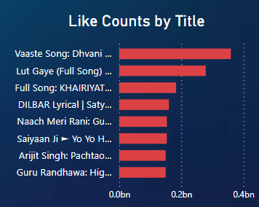

Slide 10
Inferences:
The bar chart titled "Like Counts by Title" shows the number of likes for various YouTube song titles.
Top Liked Songs:"Vaaste Song: Dhvani ...": The most liked song, with nearly 0.4 billion likes.
"Lut Gaye (Full Song)": The second most liked, with likes approaching 0.3 billion.
"Full Song: KHAIRIYAT ...": Third in popularity, with around 0.25 billion likes.
"DILBAR Lyrical | Saty ...": Also highly liked, just under 0.25 billion.
"Naach Meri Rani: Gu ...": Approaching 0.2 billion likes.
"Saiyaan Ji ➹ Yo Yo H ...",
"Arijit Singh: Pachtao ...", and "Guru Randhawa: Hig ...": All with significant likes, ranging from 0.1 billion to
just under 0.2 billion.
Key Insights:
High Engagement: Songs by Dhvani Bhanushali, Guru Randhawa, and other popular artists have high user engagement, as indicated by the number of likes.
Content Preference: The high like counts suggest that viewers prefer these specific songs and artists, highlighting trends in music preferences.

Slide 11
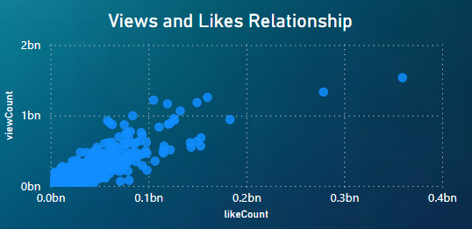
Inferences
The scatter plot titled "Views and Likes Relationship" illustrates the correlation between the view counts
and like counts of YouTube songs.
Positive Correlation: There is a general positive correlation between view counts and like counts.
Songs with higher view counts tend to have higher like counts. The majority of the data points are
clustered between 0 to 0.1 billion likes and 0 to 1 billion views.
Engagement Insights: High view counts do not always equate to proportionally high like counts, indicating
that user engagement can vary significantly. Songs with high like counts are likely to be those that
resonate well with the audience, regardless of the view count.

Slide 12
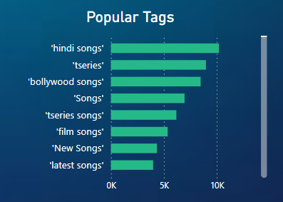
Popular music genres on social media: The most popular tags are "Bollywood songs", "New songs", "Latest songs", and "Hindi songs". This suggests that Bollywood and new music are trending. The tags 'tseries' and 'tseries songs' are frequently used, highlighting the popularity and significant presence of T-Series content on YouTube The high frequency of these tags implies user behavior and search patterns are focused on specific popular categories and well-known content creators.
Inferences:

Slide 13
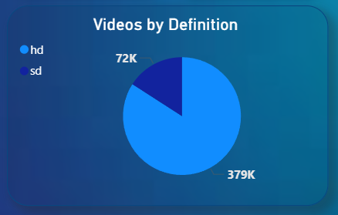
Inferences:
Based on the data, it is inferred that 72,000 individuals have expressed a preference for SD (Standard Definition), whereas 379,000 individuals have indicated a preference for HD (High Definition) when given a choice between the two video resolution options.

Slide 14
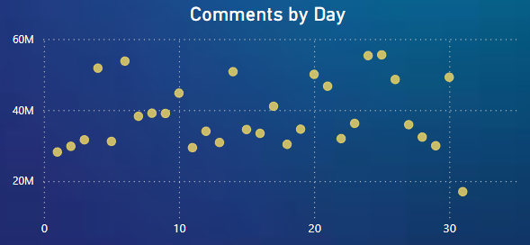
Inferences:
The number of comments varies significantly across different days. Some days see comment volumes close to 60 million, while others are as low as 10 million
There are several peaks where the comment count reaches around 60 million. These peaks indicate days of high engagement, possibly due to popular video releases, trending content, or events.
The high variability suggests that external factors such as video content, marketing efforts, day of the week, and time of the year could be influencing the number of comments significantly.

Slide 15
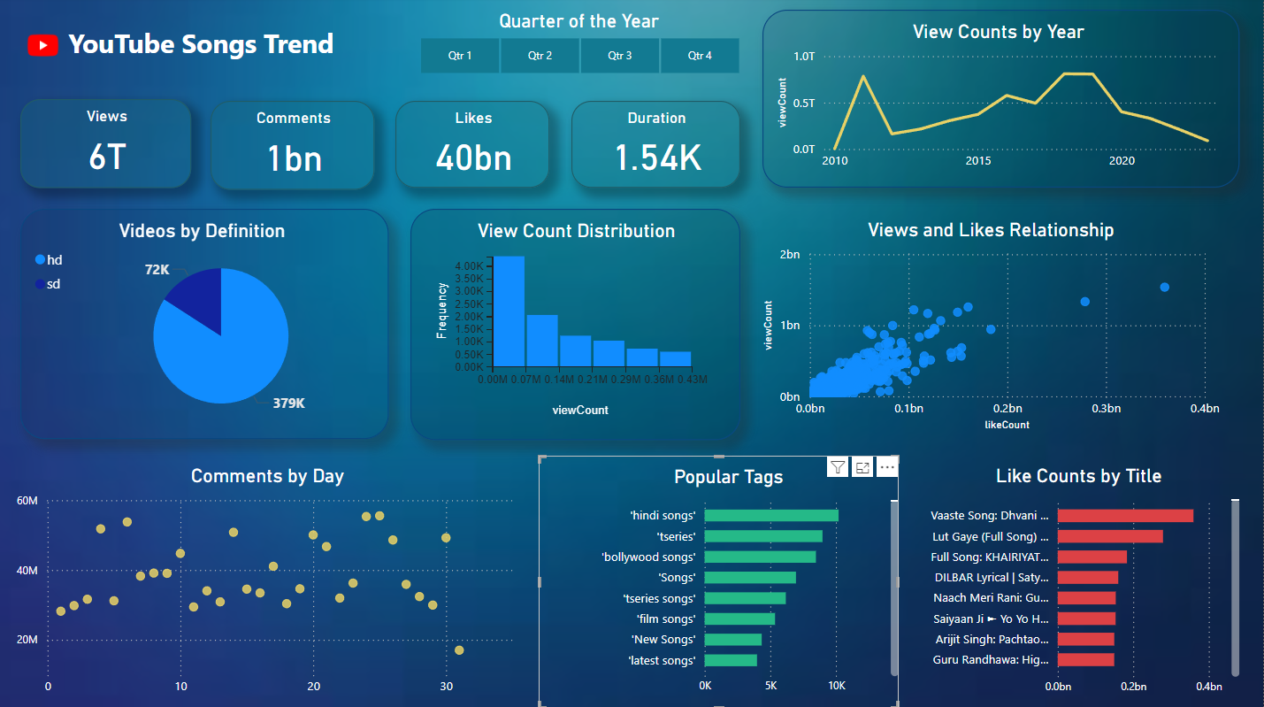

Slide 16
THANK YOU

